Slide 1
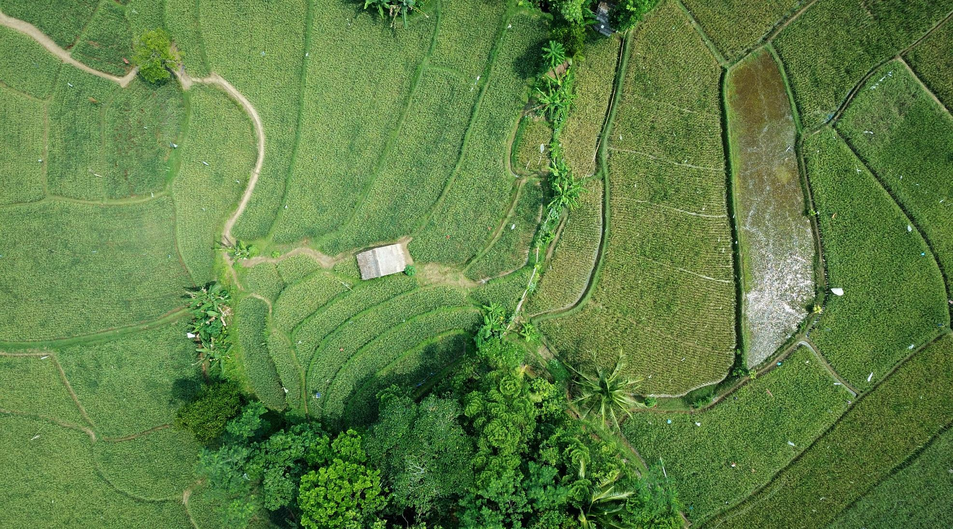



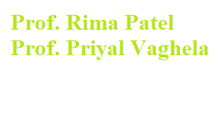
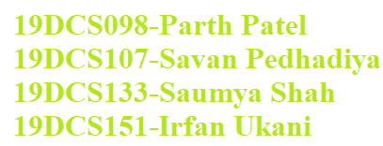
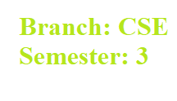
AGRIGUIDE One Stop Solution To Every Farming Needs

Slide 2


Agriguide
OUTLINE:
Introduction
Problem Statement
Motivation
Flow Chart
Product Features
System Requirements
About Us
Expected Outcomes
Limitations
Future Scope
Screen Shots
Work Cited
Timeline
One Stop Solution To Every Farming Need

Slide 3
INTRODUCTION
Agriguide is made up of two Words:
1. Agri-Related to Agriculture
2. Guide-Go along the route to show the way
Agriguide as the name suggest is a multi-purpose app which will help the farmers in decision making and to get the latest information about the trends in the Global Agriculture Market.
Android is an operating system based on the Linux kernel. It was designed primarily for touch screen mobile devices. As Android phones being used by almost 70% people we incorporated our features on the Android platform.
Agriguide uses the concept of Machine Learning to predict the crop disease.
Agriguide also gives information about which crops can be grown in particular location
Agriguide also gives latest information about new trends and policies of Farming and Agriculture Sector to the Farmers.

Slide 4





The Problem
Less information on rainfall
One crop decreases the natural fertility
Multiple Seasons
Different Terrain Different Crops
Less Use of Technology

Slide 5




What Motivated Us To Take The Initiative?
Unexplored Sector
Poor Crop Production
Demand for High Production

Slide 6

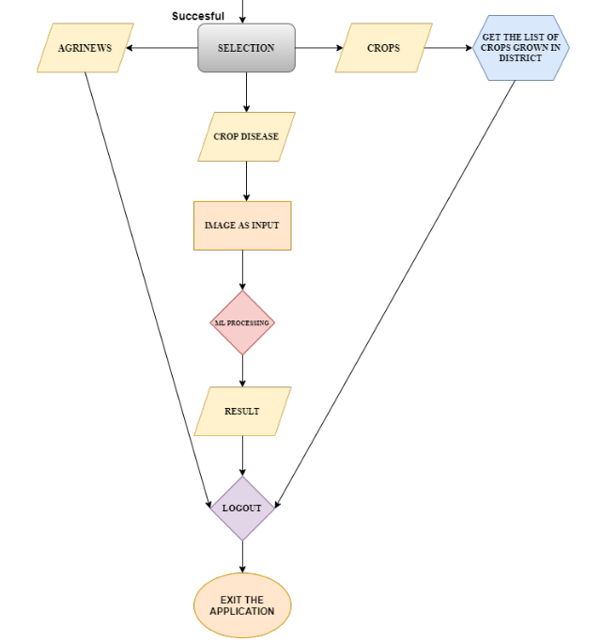
FLOW CHART

Slide 7




The Product
24/7 Support
Blog Section
Android OS

Slide 8

System Requirements
Internet Connectivity
Android 4.0 and above
Minimum 12.0 Megapixel Camera Resolution
1 GB Ram

Slide 9

ABOUT US
Team AGRIGUIDE

Slide 10




The Team
Saumya Shah
Savan Pedhadiya
Parth Patel
Irfan Ukani
10

Slide 11



Expected Outcomes
Provision of help in increase in crop production and income of Farmers
Find and treat Crop Diseases effectively and instantly
Introduction to advance technology in farming

Slide 12



LIMITATIONS
Accuracy Issues
Needs Connectivity
Limited Region Coverage

Slide 13



FUTURE SCOPE
Feature of Weather Update
Solution feature
Information of Policies

Slide 14
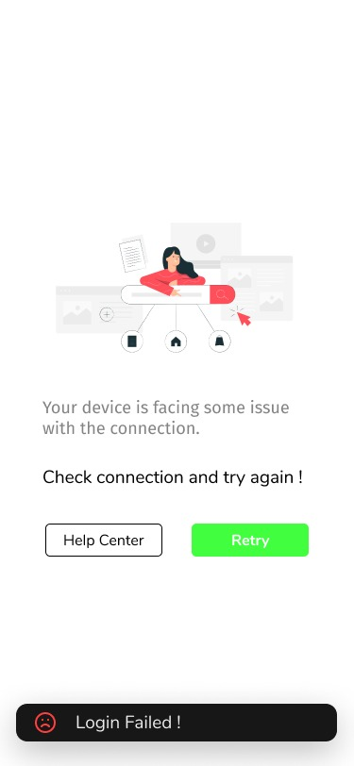
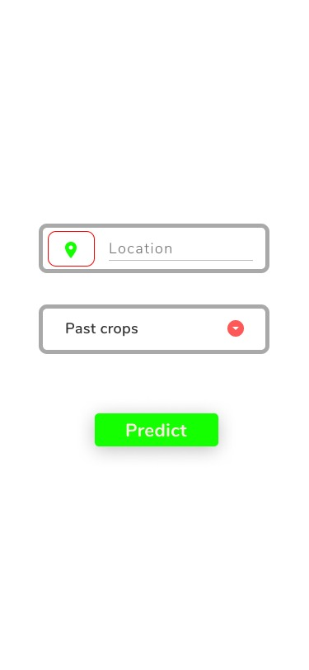

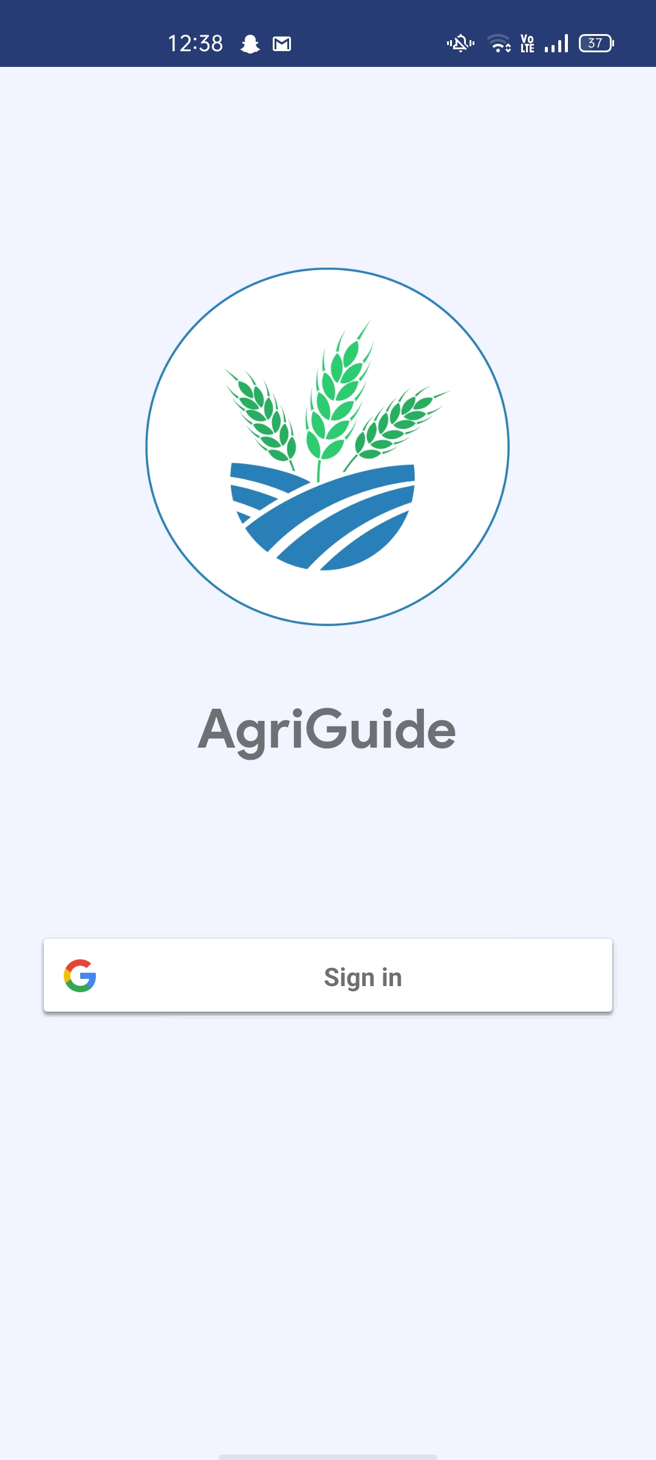
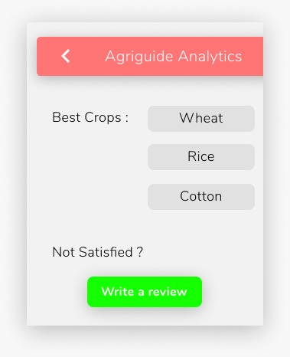
SCREEN SHOTS
Welcome Screen Login Window Network Loss Crop Search Crop Details

Slide 15
References and Work Cited
https://www.tensorflow.org/resources/learn-ml
https://www.coursera.org/learn/introduction-tensorflow/home/welcome
https://www.instagram.com/p/CEs578jgXGy/?igshid=1g8lhr3f1766e
https://colab.research.google.com/
https://stackoverflow.com/
https://www.geeksforgeeks.org/introduction-machine-learning/
https://developers.google.com/

Slide 16
Timeline
Design
Development starts
Design V2
Testing and Debugging ends
JAN
FEB
MAR
APR
MAY
JUN
JUL
AUG
SEP
OCT
NOV
DEC
JAN
FEB
MAR
APR
MAY
JUN
JUL
AUG
SEP
OCT
NOV
DEC
2020
2021
Focus Group
Development ends
Launch

Slide 17

AGRIGUIDE
THANK YOU

